Slide 1


Microbiome Workshop
Hena R. Ramay
Bioinformatician
International Microbiome Centre
University of Calgary
hena.ramay@ucalgary.ca
@henaramay

Slide 2

I’d like to acknowledge that we are on Treaty 7 territory, the traditional territories of the Blackfoot Nations, including Siksika (Sick-sick-ah), Piikani (Pee-can-ee), and Kainai (Kigh-a-nigh), the Tsuut’ina (Soot- ina), Nation and Stoney Nakoda First Nations. We acknowledge all the many First Nations, Métis, and Inuit whose footsteps have marked these lands for centuries.

Slide 3
Why do we care about microbes?

Slide 4
How are they communicating with us?

Slide 5
Omics
Biomaterial
Meta-genome
DNA
Meta-Transcriptome
RNA
Protein
Proteins
Metabolome
Sugar
Amino Acids
Nucleotide
SCFA
Source: https://slideplayer.com/slide/16950853/

Slide 6
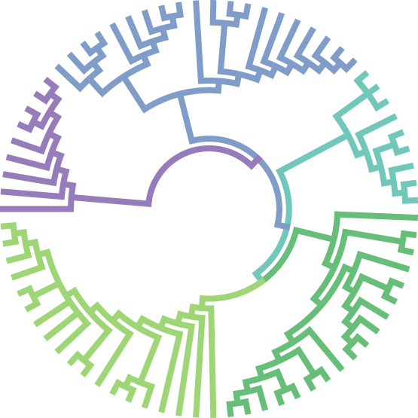
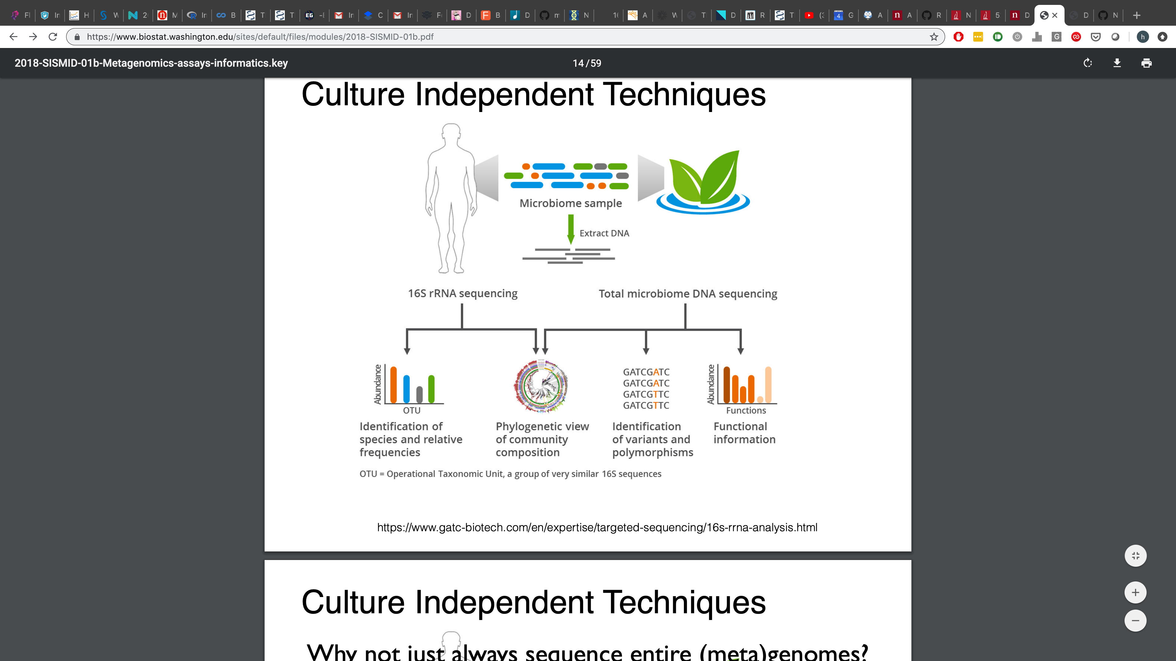
Meta-genome
Shotgun Sequencing Output
Amplicon Sequencing Output
GATCGATC
GATCGATC
GATCCATC
GATCCATC
Abundance
Abundance
+
Functions
ASV
Functional Annotation
Taxonomy
Phylogeny
Polymorphism
ASV: Amplicon Sequence Variant

Slide 7
Amplicon Sequencing
What should we amplify?

Slide 8
The Small Subunit 16s ribosomal RNA gene
0
1500 bp
V1
V2
V3
V4
V5
V6
V7
V8
V9
Conserved Regions Variable Regions
Highly conserved gene found in most bacteria
A variety of hypervariable region
Notes:
Because this gene is conserved and found in most bacteria, it is used for reconstructing phylogeny.
Depending on the hypervariable region picked, you can classify to different level of taxonomy

Slide 9
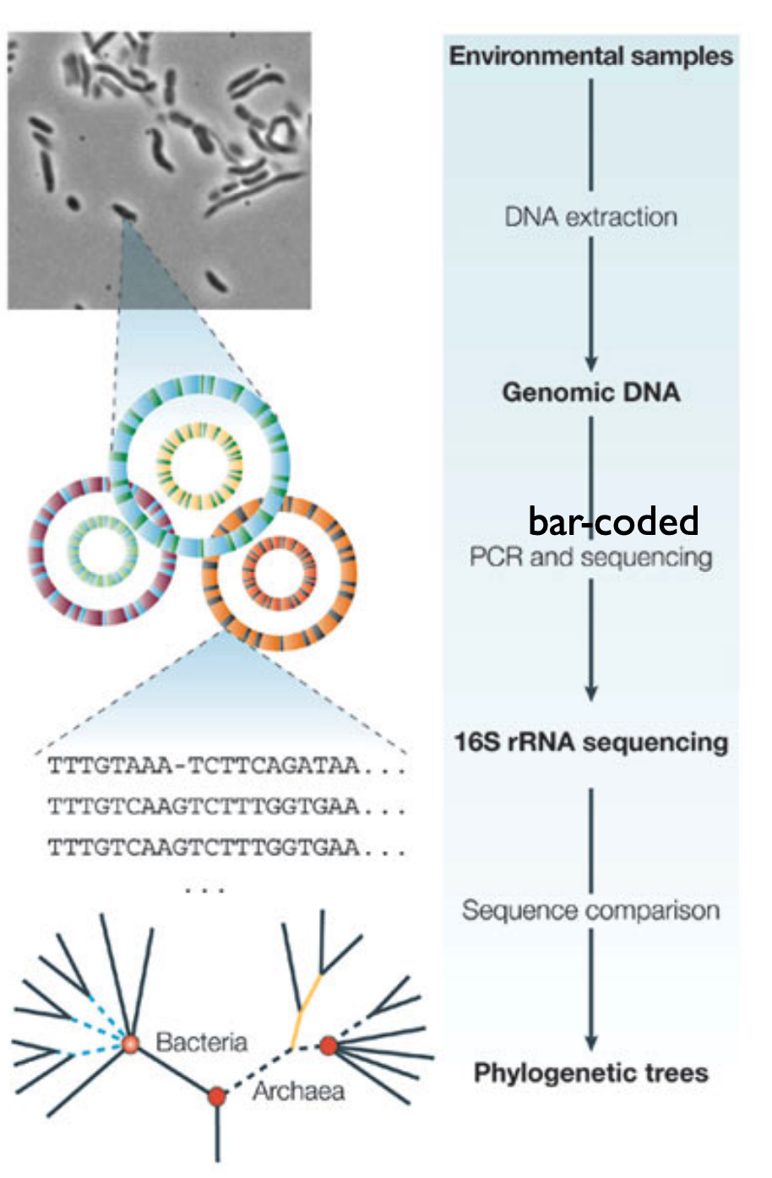
Many microbiomes in parallel
Break all cells, extract all DNA
PCR-amplify 16s rRNA genes using bar-coded primers
Sequence samples
Cluster sequences after De-multiplexing for each sample
Count each species
https://www.biostat.washington.edu/sites/default/files/modules/2018-SISMID-01b.pdf

Slide 10

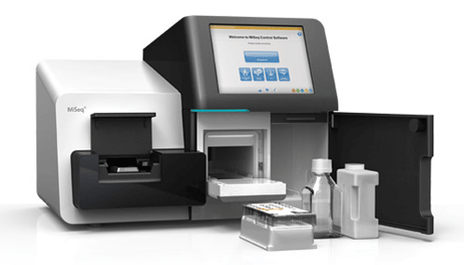

Amplify 16s region
ASV Table
 | Sample 1 | Sample 2 | Sample 3
ASV 1 | 0.5 | 0.4 | 0.6
ASV 2 | 0.2 | 0.3 | 0.1
ASV 3 | 0.2 | 0.1 | 0.2
ASV 4 | 0.1 | 0.2 | 0.1
Amplicon Sequencing Cycle
Bacteria + Archaea
ASV 1 = Bug X
Abundance
ASV: Amplicon Sequence Variant is a sequence detected with a certain abundance in one or more samples
Phylogeny
Samples

Slide 11
Typical Workflow

Slide 12
Thoughtful data analysis is critical for successful taxonomic assignment

Slide 13
What do we know about our data?
16s Region
Which region was sequenced, read length & depth
Controls
Did you use negative (extraction) and positive (mocks) ?
Feasibility
Will this data answer the questions asked by the investigator?
Read Assignment
Are the reads assigned correctly to each sample?
Sample size
Are there enough samples for down stream analysis

Slide 14
16 rRNA
0
1500 bp
V1
V2
V3
V4
V5
V6
V7
V8
V9
Conserved Regions Variable Regions
Pick a variable region
V3-V4
Pick a sequencing technique
Illumina (MiSeq)
Select primers & Read lengths
Overlap
FWD
Primer
Read length
Primer
REV
Make sure there is an overlap!!!!

Slide 15
The common path
Reads
Quality
Control
Remove Chimeric
Seqs
Denoise
Classify
Check Read Quality
Correct Errors
Merge Reads
Select Database
Remove Primers
Dereplicate
Check CHIMERA
Assign Taxonomy
Quality Filter & Truncation
Phix Contamination
How do we select the tools and use them well ?

Slide 16
Paired End Reads
Overlap
FWD
Primer
Read length
REV
Region | Read length | Amplicon Length | Overlap
V3 | 150 | ~170 | 130
V3-V4 | 300 | ~462 | 133
V4 | 150 | ~254 | 46
V4 | 250 | ~254 | 246
% of bases > Q30
Read Length PE
Source: Illumina
Notes:
The amplicon/fragment is read from either end and this is used to generate the read pairs .

Slide 17
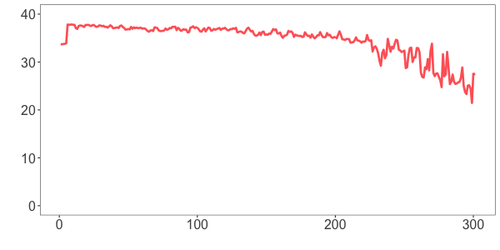
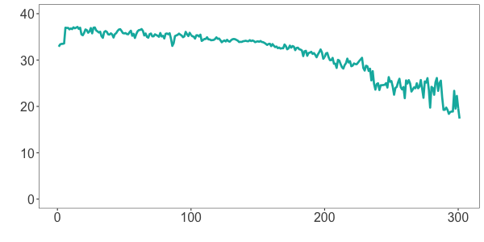
Base Quality differs between Fwd and Rev Reads
Primer
FWD
REV
Average Quality Score
Forward
Reverse
0
100
200
300
400
Base position in a read
Tools
FastQC FastQp MultiQC & Specialized 16s rRNA packages
Source: Dada2 R package

Slide 18
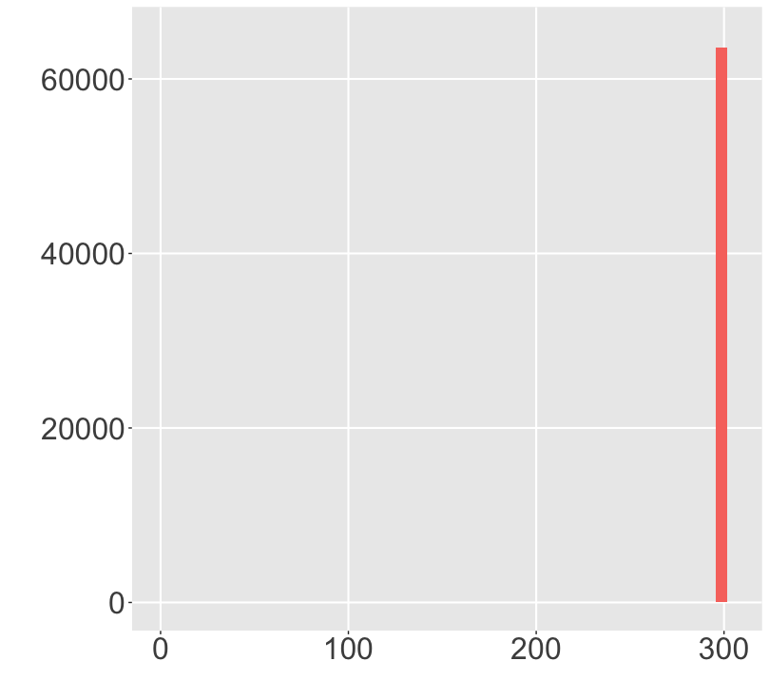
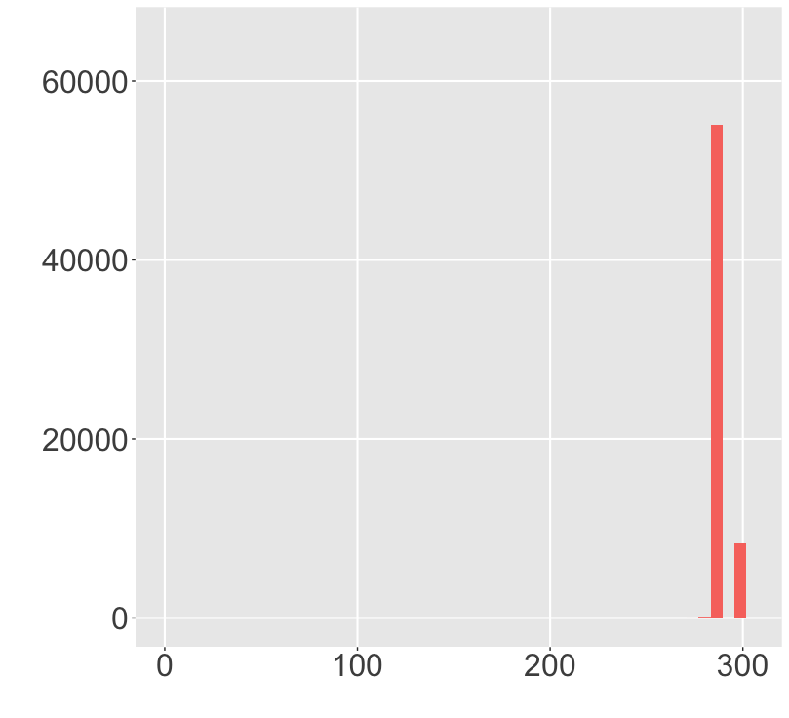
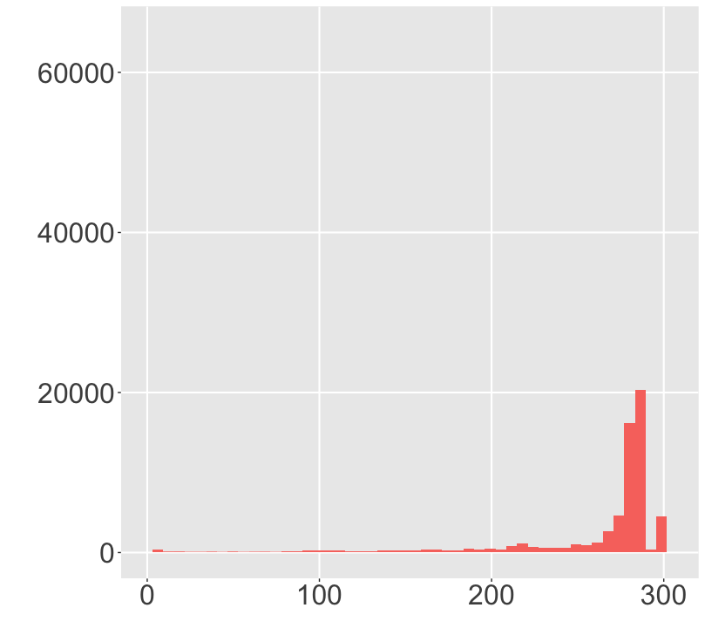
Trimming & Quality Filtering
Raw Reads
Remove Primers
Quality Trimming
Counts
Read Length
Read Length
Read Length
Tools
CutAdapt

Slide 19
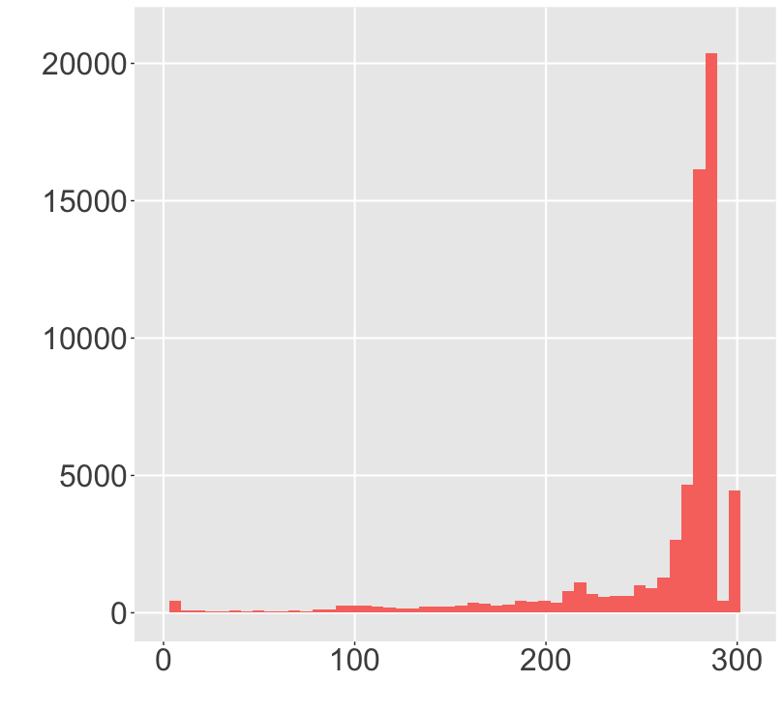
Trimming & Quality Filtering
Available Methods
Minimum Q (Q >= 20)
Truncate if 3 consecutive bases are Q < 3
Expected Errors
Truncation
Counts
Read length | % of reads
10 | 98.96
100 | 96.97
200 | 89.3
250 | 80.5
Read Length
Source: Edgar et al., 2015

Slide 20
The common path
Reads
Quality
Control
Remove Chimeric
Seqs
Denoise
Classify
Check Read Quality
Correct Errors
Define Clusters
Select Database
Remove Primers
Dereplicate
Check CHIMERA
Assign Taxonomy
Quality Filter & Truncation
Phix Contamination

Slide 21
Denoising reads

Slide 22
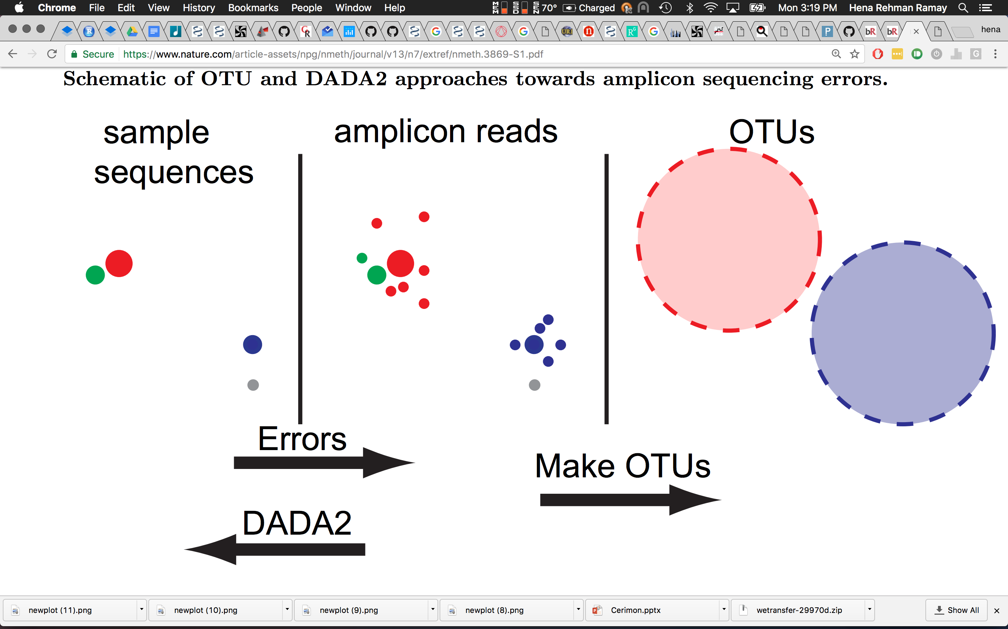
Clustering
(Operational taxonomic Unit)
97 % Identity
97 % Identity
(OTUs are not strains)
OTUs: Lump similar sequences together
DADA2: Statistically infer the sample sequences (Amplicon sequence variants: ASVs)
Source: Callahan et al.,2016

Slide 23
Clustering
97 % Identity
97 % Identity
DADA2
High Resolution & Accuracy
Source: Callahan et al.,2016
Notes:
High Resolution: DADA2 infers exact sequence variants from amplicon data, resolving differences of even 1 or 2 nucleotides.
Accuracy: DADA2 reports fewer false positive sequence variants than other methods report false OTUs.

Slide 24
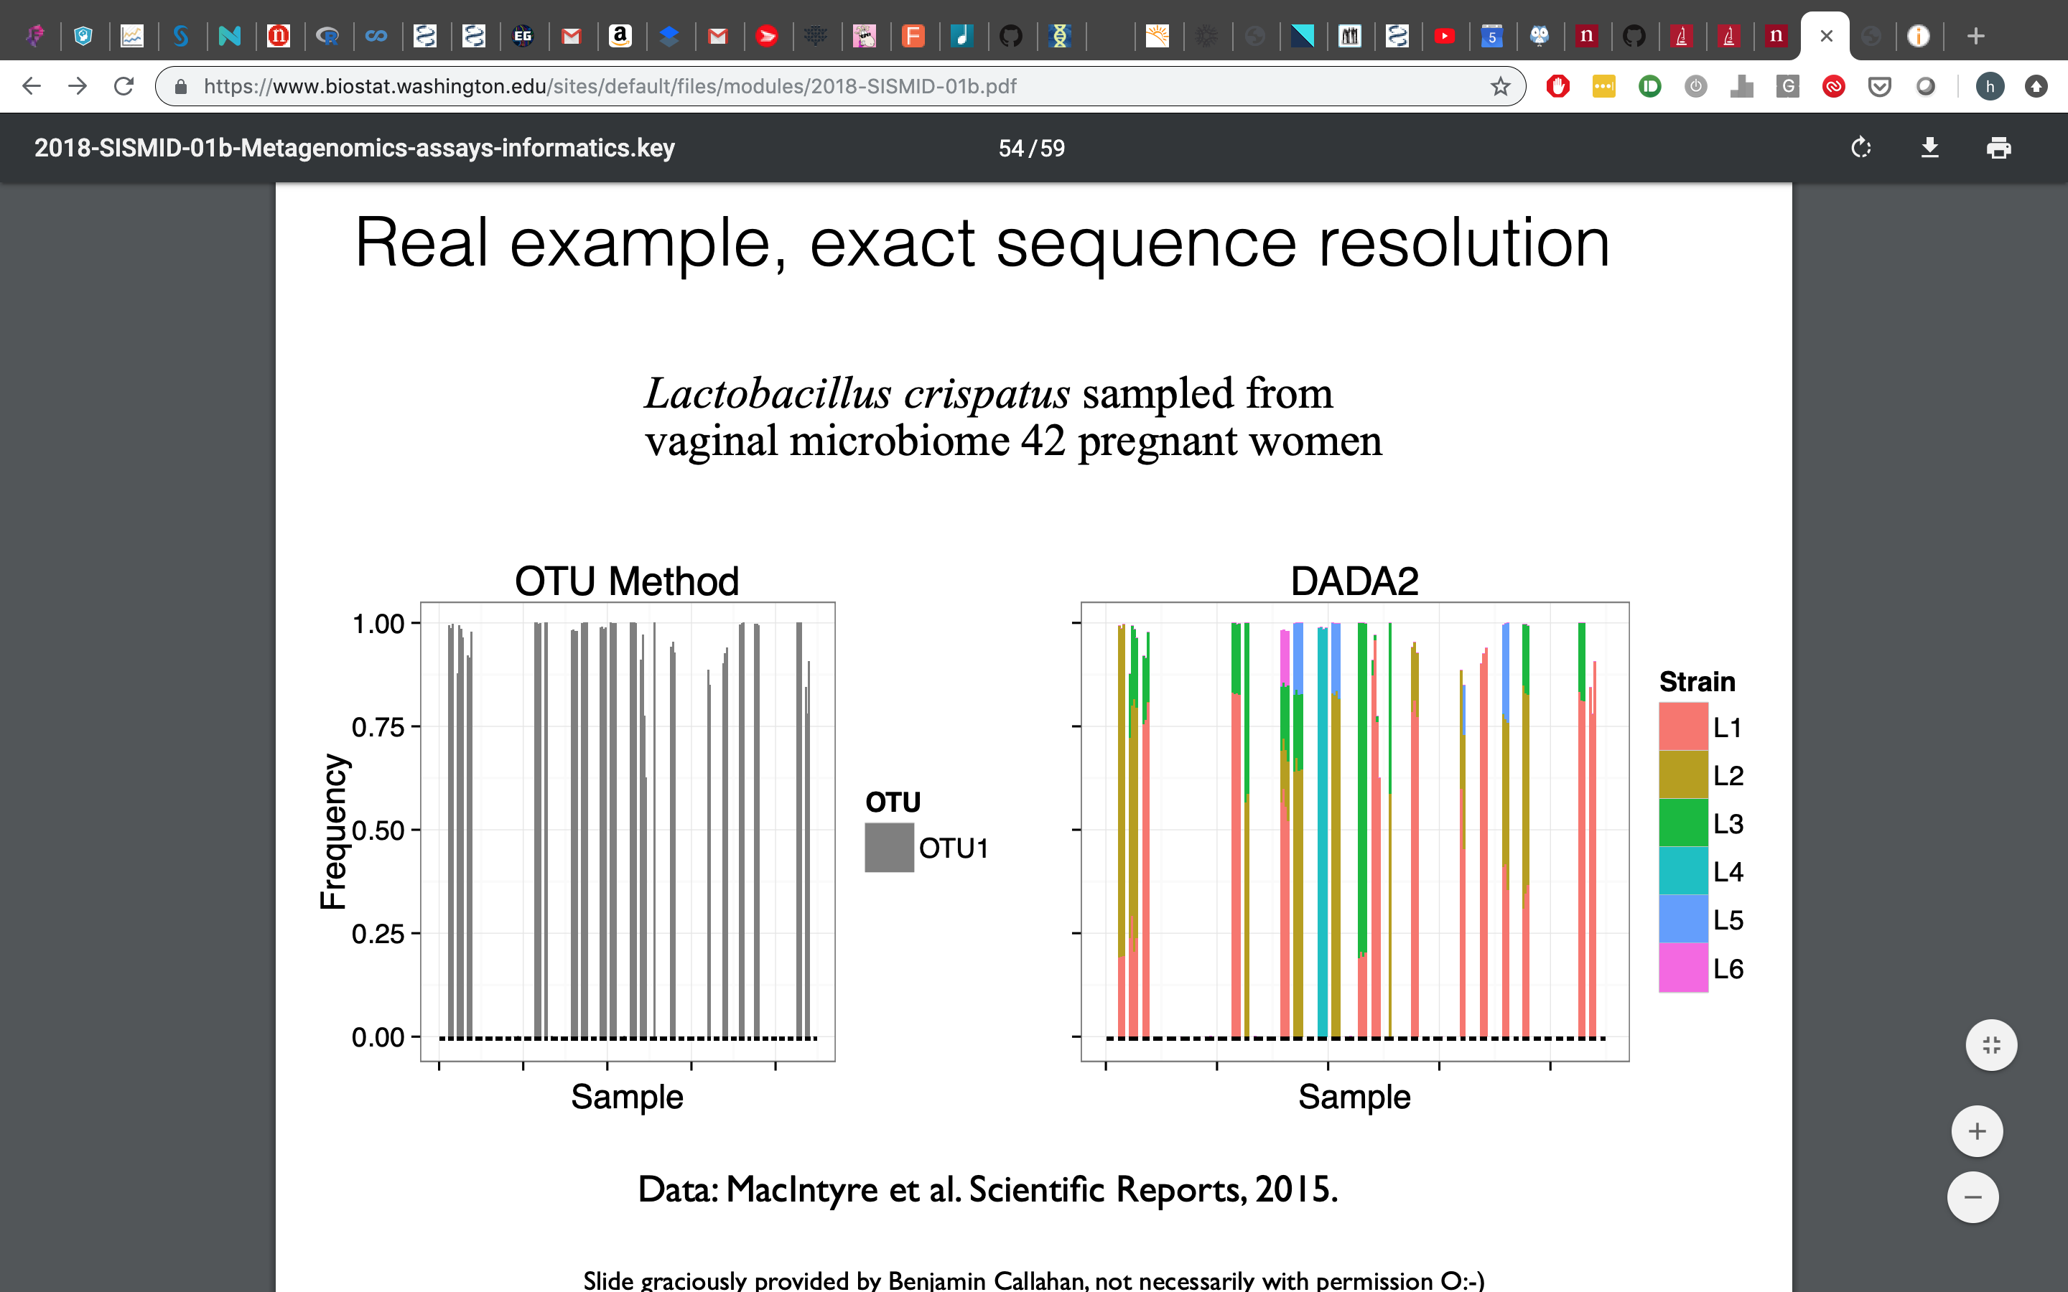

Slide 25
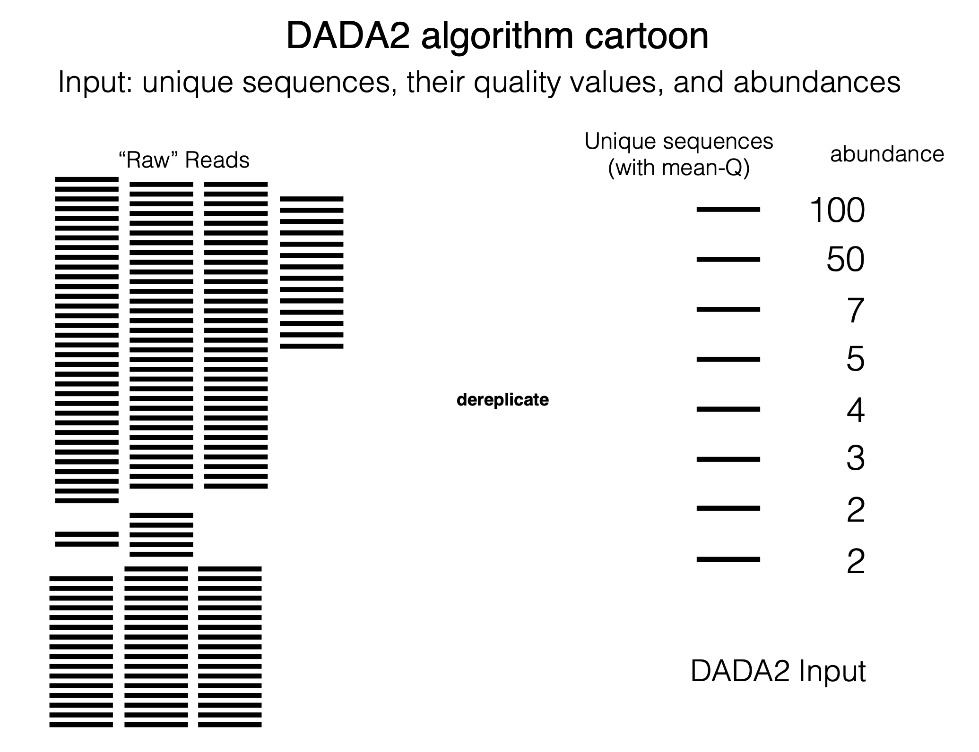
https://www.biostat.washington.edu/sites/default/files/modules/2018-SISMID-01b.pdf

Slide 26
The common path
Reads
Quality
Control
Remove Chimeric
Seqs
Denoise
Classify
Check Read Quality
Correct Errors
Merge Reads
Select Database
Remove Primers
Dereplicate
Check CHIMERA
Assign Taxonomy
Quality Filter & Truncation
Phix Contamination

Slide 27
Merge Paired End Reads
Overlap
FWD
Primer
Read length
REV
Chimeric Sequences
Biological Sequence X
Biological Sequence Y
Chimera formed from X and Y
Created during PCR
Fragment primes different extension
About 1-5 % of reads are chimeric
Source: Lahr & Katz, 2009
Notes:
Chimeras are sequences formed from two or more biological sequences joined together. Amplicons with chimeric sequences can form during PCR. Although chimeras can be formed by a number of mechanisms, the majority of chimeras are believed to arise from incomplete extension. During subsequent cycles of PCR, a partially extended strand can bind to a template derived from a different but similar sequence.

Slide 28
Important
DADA2 gives us Amplicon sequence Variants (ASVs) not operational taxonomic units OTUs

Slide 29
The common path
Reads
Quality
Control
Remove Chimeric
Seqs
Denoise
Classify
Check Read Quality
Correct Errors
Merge Reads
Select Database
Remove Primers
Dereplicate
Check CHIMERA
Assign Taxonomy
Quality Filter & Truncation
Phix Contamination

Slide 30
Taxa levels
Reference Databases
Kingdom
Phylum
Class
Order
Family
Genus
Species
Taxonomy | Type | No. of nodes | Lowest rank | Latest release
SILVA | Manual | 12,117 | Genus | Dec 2017
RDP-II | Semi | 6,128 | Genus | Sep 2016
Greengenes | Automatic | 3,093 | Species | May 2013
GTDB | Automatic | 143,512 | Species | Todayª
Source: Balvočiūtė et al 2017
Use frequently updated and well curated databases!

Slide 31
Diversity
Alpha diversity
Beta diversity
Within sample diversity
Who is in the sample
Between sample diversity
How similar at the samples
Uses Abundance and/or observed number of each ASV
Distance metric & clustering
Jaccard | Unifrac
Bray-Curtis | Weighted- Unifrac
Absent/Present
Shannon, Simpson, Chao1
Richness , Evenness
Abundance

Slide 32
Beta Diversity
 | Sample 1 | Sample 2 | Sample 3
Sample 1 |  | 0.2 | 0.6
Sample 2 | 0.2 |  | 0.5
Sample 3 | 0.6 | 0.5
Each Axis represents a percentage of variability it explains of the data.
Methods
PCoA
NMDS
CCA
Axis 2
Axis 1

Slide 33
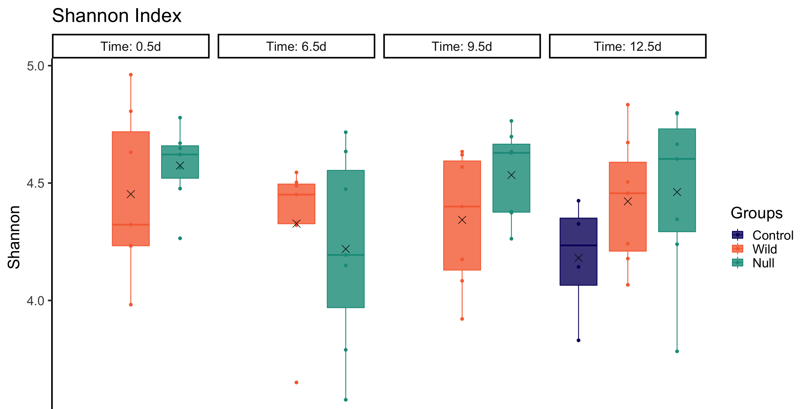

Slide 34
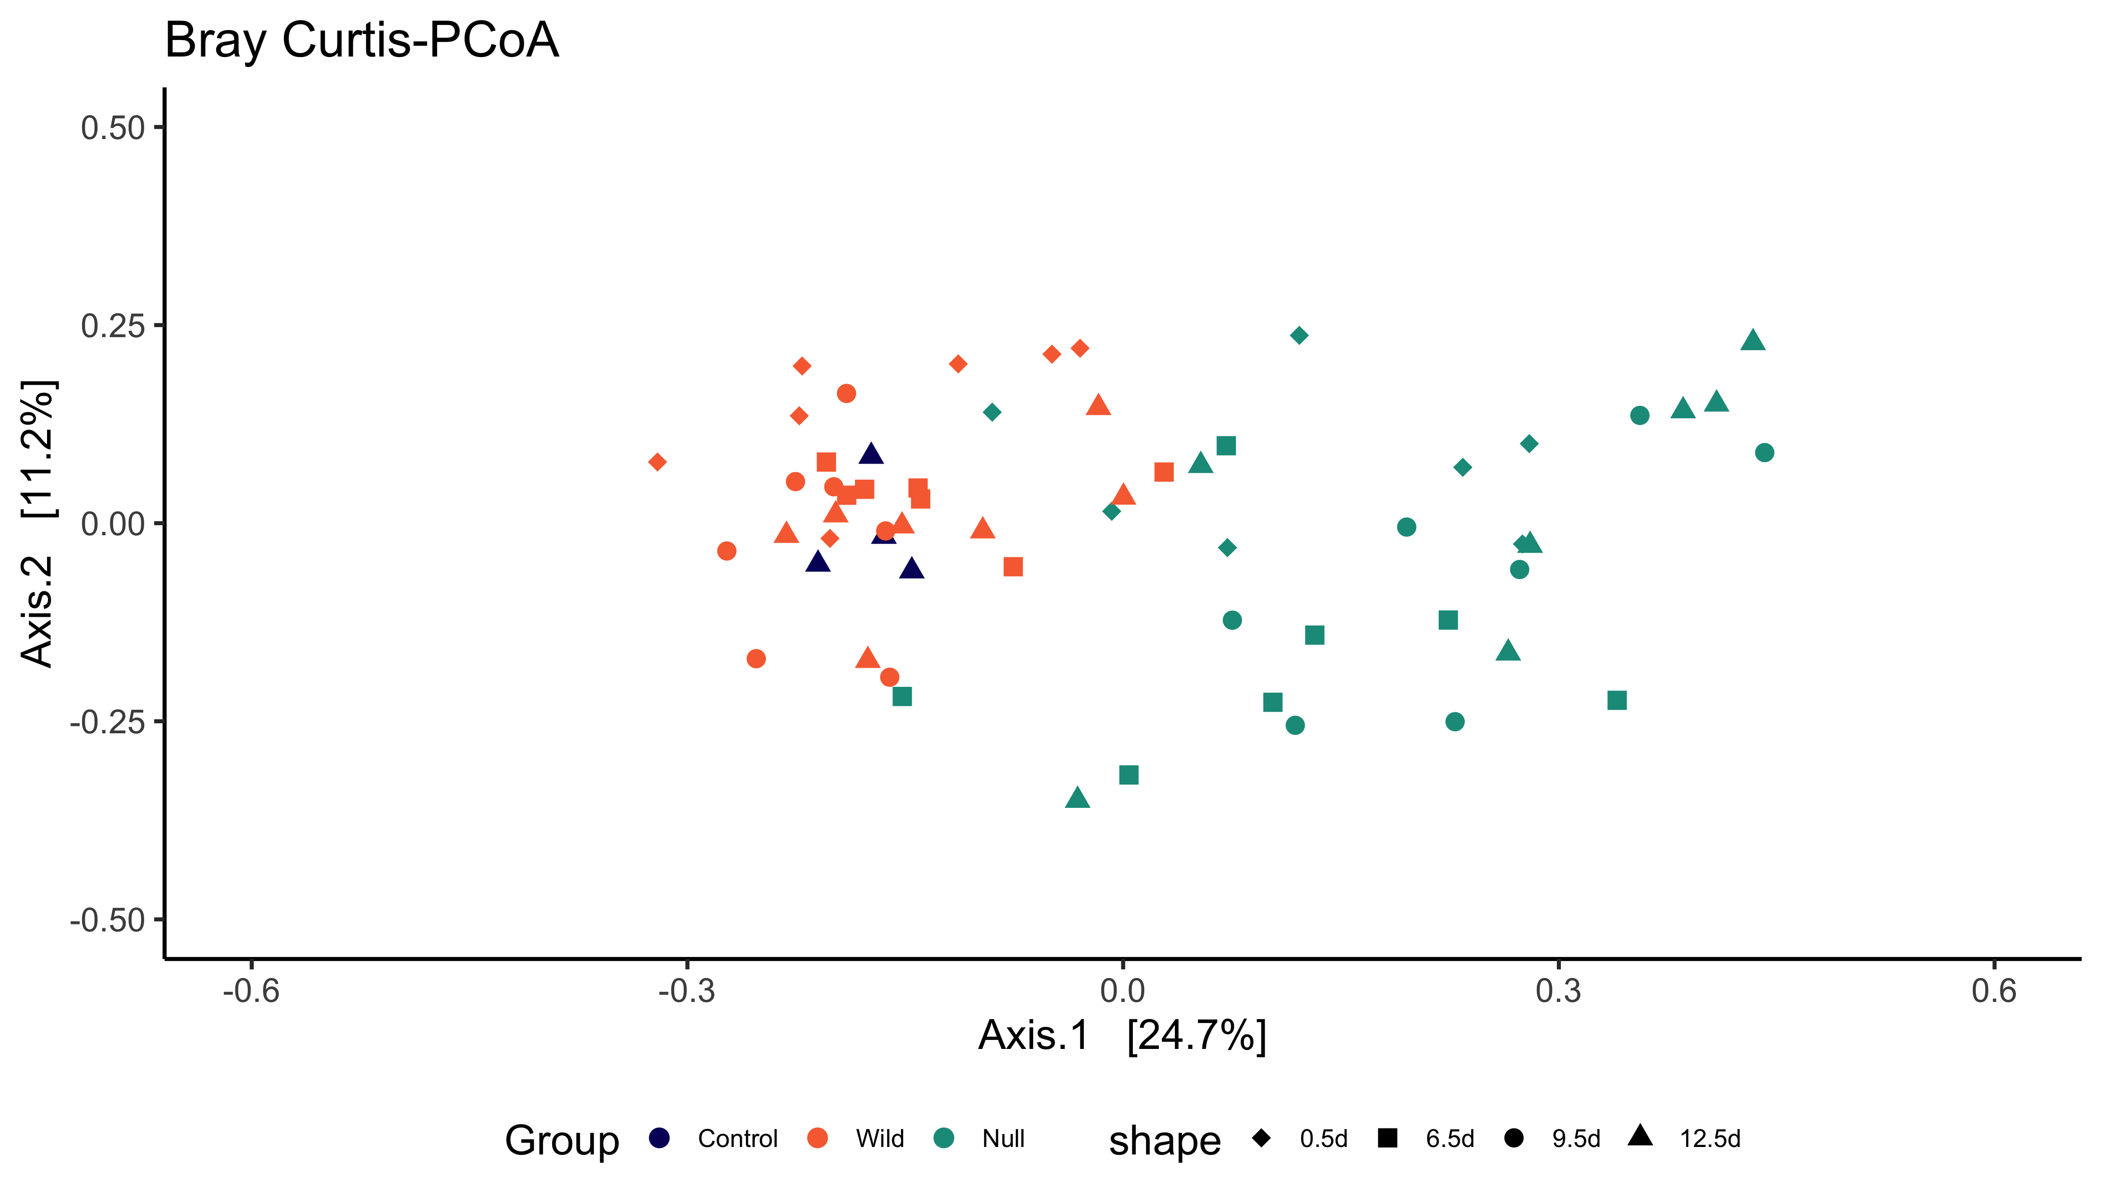

Slide 35
What next?
Differential abundance analysis
Network analysis
Predictive functional analysis

Slide 36
Differential Abundance Analysis
Are there any taxa that are present in different abundance in the two types of cat?

Slide 37
Methods (to name a few)
DESeq2
Maaslin2
edgeR
metagenomeSeq
ANCOM2
ANCOM-BC
corncob
ALDEx2

Slide 38
"If you torture the data long enough, it will confess."
- Ronald Coase, Economist

Slide 39
Tips
Sample size
Are there enough samples for down stream analysis
Controls + & -
Helps identify contaminants
Think before you start and ask why!
Length & Depth
Know which region, read length & depth
suits your experiment
Be consistent
It is much better to use the same methods than to change methods frequently

Slide 40
Shotgun Metagenomics

Slide 41
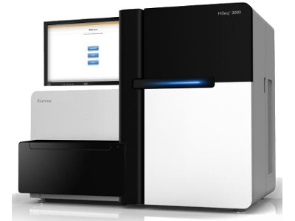

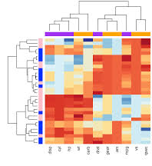
Total DNA
Functional Annotation
+ Metabolite prediction
Assembly
Phylogeny
Taxonomic profile
Marker Gene Identification or
Kmer exact match classification
Abundance
Samples

Slide 42
Taxa levels
Kingdom
Phylum
Class
Order
Family
Genus
Species
Strain
Limitations
Avoids PCR bias but has it’s own
Computationally intense
Did we get enough data to identify the whole community ?

Slide 43
Metabolomics
Identification and quantification of metabolites

Slide 44

Who
How
Microbes
Metabolites
Host
Sugar
Amino Acids
Nucleotide
SCFA

Slide 45


Metabolomics
Untargeted
Targeted
Global profiling
Qualitative
Measure a specific known set of metabolites
Quantitative
Separate
Detect
Analyze
Chromatography
By size and charge
NMR or Mass spectrometry

Slide 46
Detection options
LC/MS
NMR
Separation is required
Can resolve metabolites in complex mixtures
High Sensitivity and range
Expensive and serious batch effects
No separation required
Smaller number of biomarkers is detected
Lower sensitivity
Reproducible and free of batch effects

Slide 47
Data Acquisition: Spectra, NMR
Data Processing: QC, normalization and statistical analysis
Typical Analysis
Data Investigation: Enrichment analysis or pathway analysis
Data Integration: Putting together with other omics data
Source: https://slideplayer.com/slide/16950853/

Slide 48
Multi-Omics Approach
Putting it all together

Slide 49

Who
Host
Transcriptome
Immune Markers
Microbes
Metabolites
Meta-Transcriptome

Slide 50
